Slide 1
CHURN ANALYSIS
USING CART ANALYSIS

Slide 2
CONTENTS
WHAT
WHY
DATASET- DESCRIPTION
PREPROCESSING
EDA
CORRELATION ANALYSIS
REGRESSION ANALYSIS
MODEL BUILDING
APPLICATIONS

Slide 3
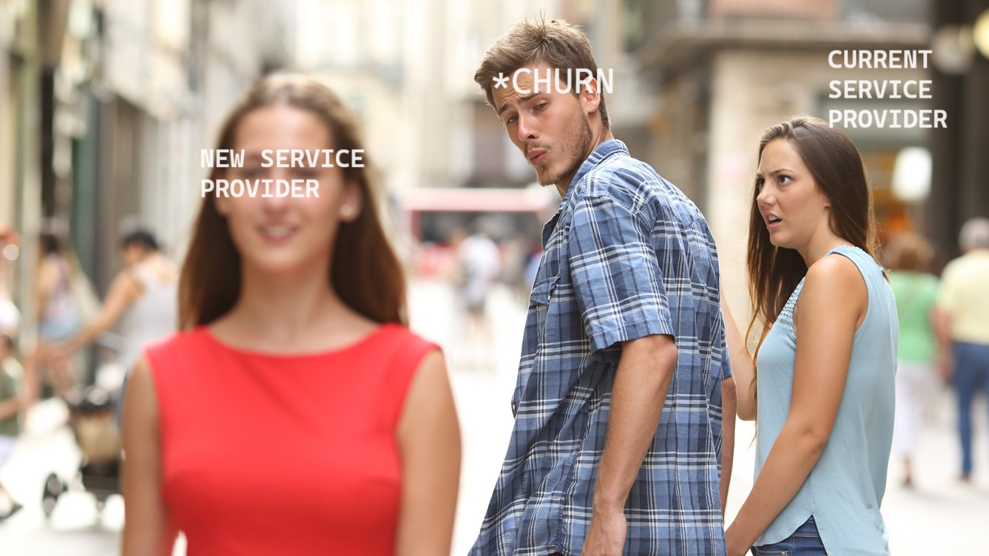
WHAT
Churn refers to the rate at which customers discontinue their relationship with a product or service over a specific period.

Slide 4
WHY
Revenue Protection
Customer Retention Strategies
Operational Efficiency
Competitive Edge
Data-Driven Decision Making

Slide 5
DATASET- DESCRIPTION
Data set : https://www.kaggle.com/datasets/blastchar/telco-customer-churn/data
Each row represents a customer, each column contains customer’s attributes described on the column Metadata.
The data set includes information about:
Customers who left within the last month – the column is called Churn
Services that each customer has signed up for – phone, multiple lines, internet, online security, online backup, device protection, tech support, and streaming TV and movies
Customer account information – how long they’ve been a customer, contract, payment method, paperless billing, monthly charges, and total charges
Demographic info about customers – gender, age range, and if they have partners and dependents

Slide 6
DATA PRE-PROCESSING
Dealing with missing values
Dealing with duplicated values
Formatting the Data
Creating numerical and categorical lists
Dealing with outliers (Tukey’s (1977) technique )

Slide 7
EDA
Numerical Features vs Target Variable (Churn)
Categorical Features vs Target Variable (Churn)
Customer information: Gender, SeniorCitizen, Partner, Dependents
Provided services: PhoneService, MultipleLines, InternetService, StreamingTV, StreamingMovies
Support services: OnlineSecurity, OnlineBackup, DeviceProtection, TechSupport
Payments: Contract, PaperlessBilling, PaymentMethod

Slide 8
Significant variables
CORRELATION ANALYSIS:
"TotalCharges" "MonthlyCharges"
REGRESSION ANALYSIS
## [1] "SeniorCitizen1" "PhoneServiceYes"
## [3] "MultipleLinesYes" "InternetServiceFiber optic"
## [5] "InternetServiceNo" "OnlineSecurityYes“
## [7] "OnlineBackupYes" "TechSupportYes"
## [9] "StreamingTVYes" "StreamingMoviesYes"
## [11] "ContractOne year" "ContractTwo year"
## [13] "PaperlessBillingYes" "PaymentMethodElectronic check"
## [15] "tenure.group12-24 months" "tenure.group24-48 months"
## [17] "tenure.groupOver 48 months"

Slide 9
MODEL
The model is built based on the stepwise selection process, optimizing the AIC. AIC (Akaike Information Criterion) is a measure of the model’s goodness of fit, penalizing for complexity. Lower AIC indicates a better-fitting model

Slide 10
APPLICATIONS
Customer retention strategies
Personalization and customer engagement
Feedback mechanisms and improvements based on customer input
Recommendations for ongoing churn management
Continuous monitoring and adaptation of strategies

Slide 11
THANK YOU

